Slide 1
HIGHLIGHTS from Les Walkling
Fine Art Reproduction Workshop – September 2015 at CCP
By Sandra Kontos

Slide 2
Interesting point
The duality of photography - what’s in front of the lens and what’s behind it.
Artists are obsessed with concepts and ideas & what’s in front of the camera just describes what is in their heads.
Photojournalists are obsessed with what’s in front of the lens. The camera is a tool to capture what they are seeing.

Slide 3
EquaLight 3
Balance light with EquaLight software. (Hasselblad compensates for lens & lighting falloff but not Nikon or Canon)
Equalight compensates an image for lens falloff and lighting falloff. Lens falloff, is a result of bending light through a lens and its aperture. The wider angle the lens, the more the light intensity falls off from the center to the edge of the image.

Slide 4
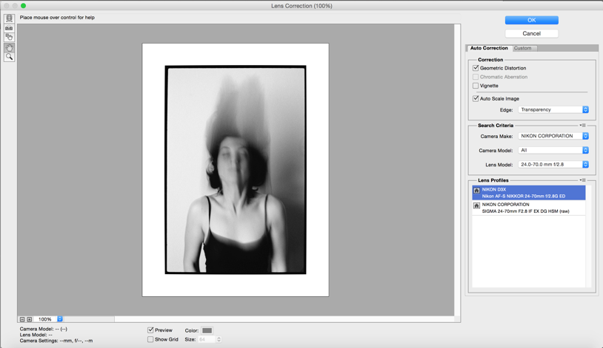
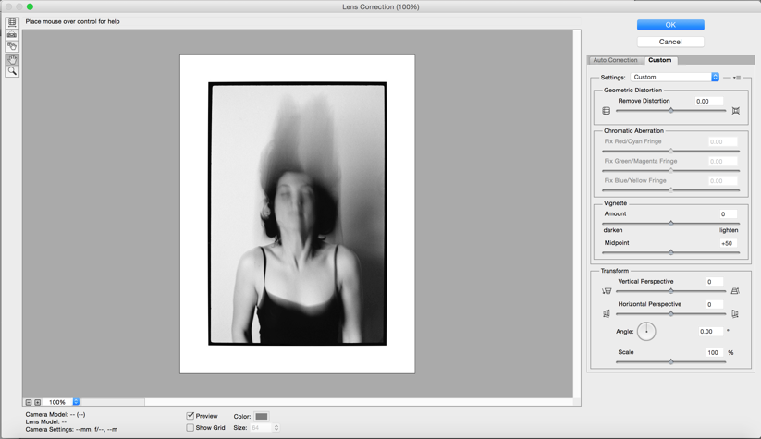
Not all lenses are equal
50mm what your eye sees in full frame 35mm camera.
Use filter > lens correction & chromatic aberration.

Slide 5
Vignetting
Vignetting ceases 3 stops from smallest aperture.
e.g. f2.8 f4 f5.6 f8 f11 f16 f22
At f2.8 most vignetting on most modern lenses, especially on prime/fixed lenses with very large apertures. At the widest apertures, the light that enters the lens is partially blocked by the lens barrel. Once stopped down, the smaller size of the aperture in the center is visible even from the corners, allowing the light to pass through.
At f22 most diffraction - smaller hole so light bends & defocuses the light.
f8

Slide 6
Helicon Focus Stacking
Take several shots at different focus distances and Helicon Focus will quickly and smartly combine the stack into a fully focused image.

Slide 7
D.O.F calculator app

Slide 8
2 forms of lighting
i) NOTAN – Eastern, flat, areas lit without lines around them.
Edward Weston, Nude on Sand, 1936

Slide 9
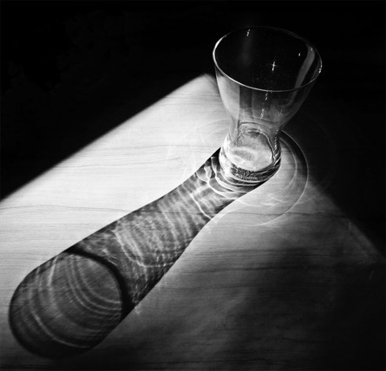
2 forms of lighting
ii) CHIAROSCURO - is an Italian artistic term used to describe the dramatic effect of contrasting areas of light and dark in an artwork. It comes from the combination of the Italian words for "light" and "dark.”

Slide 10
Photographing 2D Objects
No personal lighting. No sense of 3D. No chiaroscuro.
Negate the ground so we can clearly see the object.
Use tape measure to measure the lights from the wall & double the distance to the camera.
1 light & 1 reflector to create 1 shadow (2 lights at 45 degrees will create 2 shadows & this sends the brain into chaos)
Key (classic Hollywood lighting) & fill light (on top of the lens – Notan light)
Double the focal length of the lens for copy work - 100mm for Nikon. The longer lens make light equal.

Slide 11
Use a metal wall & magnets to “pin” works to the wall (use paper in between the work & magnets to protect the original)
Draw a centre line on studio wall & floor. Tripod in the middle. We have now turned the studio into a copy stand.
Hold a mirror in the middle of the work. Look through the lens to make sure the lens in the middle of the work. (N.B. Use mirror on a copy stand as well)
Hasselblad multi-shot, 1 registration, 2,3,4 RGB
National Archives of Australia Digitisation Standards http://www.naa.gov.au/Images/Digitising-accumulated-physical-records-April-2011_tcm16-47278_tcm16-70173.pdf

Slide 12
Note to self…
Have the same sensitivity as the artist when you photograph an object, or the curator so you know what’s important to depict.
2 conversations
The literalness, the factual, the shape of the object
The interpretative, all the qualities the artist imbued into the work is also very important.
Photographing the materiality of the surface is very important. Rake the lights to show texture of the paint.

Slide 13
Wishlist – Arca Swiss tripod head

Slide 14
Wishlist – Sigma dp3 Quattro
29MP Foveon X3 Quattro CMOS Image Sensor
TRUE III Image Processing Engine
50mm f/2.8 Lens (35mm Equivalent: 75mm)
3.0" 920k-dot TFT LCD Screen
ISO Range: 100-6400 in 1/3 Steps
RAW Image Capture
Max RAW Resolution of 5,424 x 3,616
Contrast Detection Autofocus
Manual Focus Ring
P/S/A/M Exposure Control
The Sigma dp3 Quattro Digital Camera combines the 29MP Foveon X3 Direct Image Sensor with the TRUE III image processing engine to create high quality images with an equivalent resolution of 39 megapixels due to the unique sensor design. This method uses layers of pixels to capture the color data of the red, green, and blue spectrums vertically, requiring no interpolation. This results in a sharper image with better color gradations.

Slide 15
The difference between Foveon X3 & Mosaic Capture

